Slide 1

Robert J Harper

Slide 2
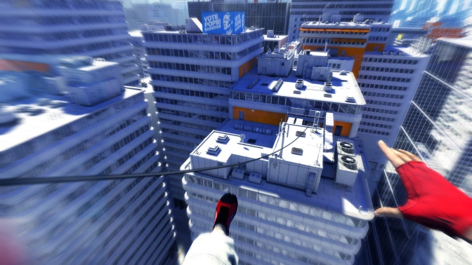
Game Summary

Slide 3
Gameplay Mechanics

Slide 4
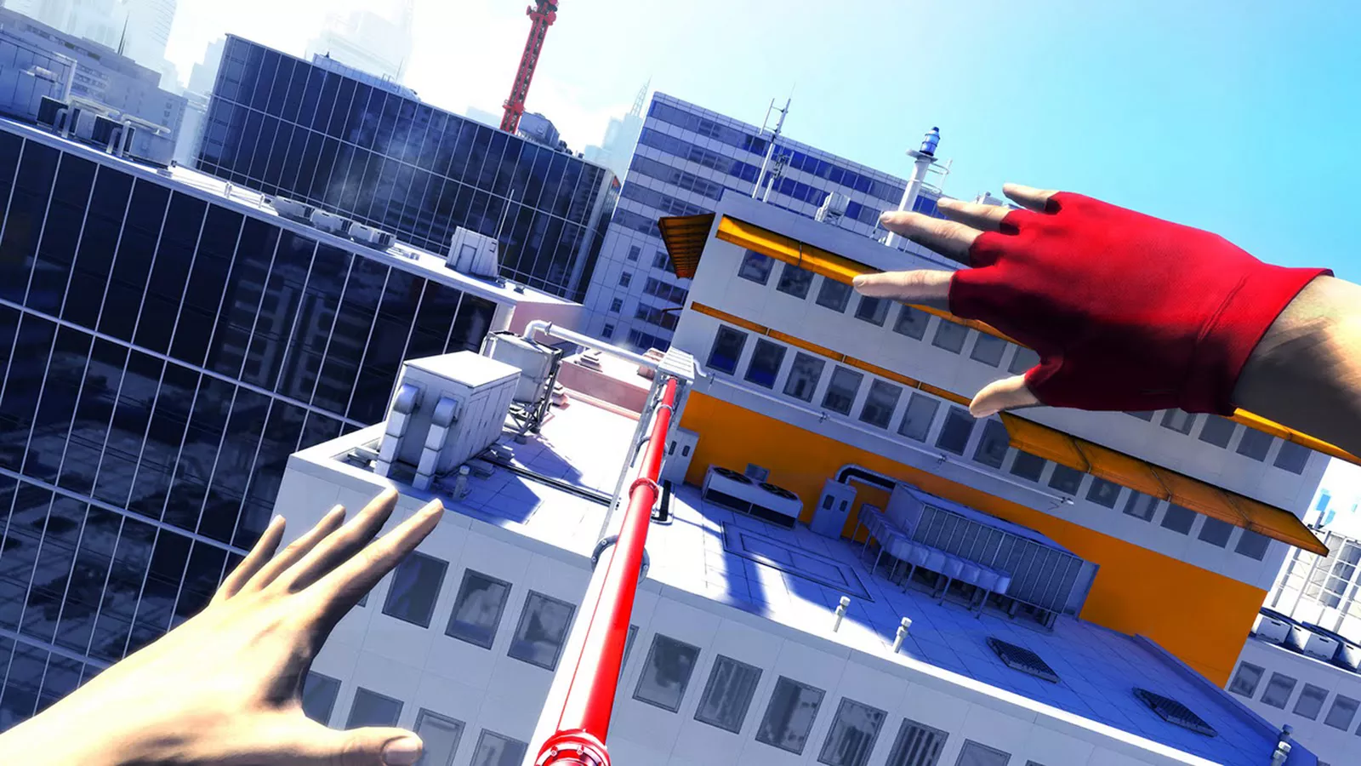
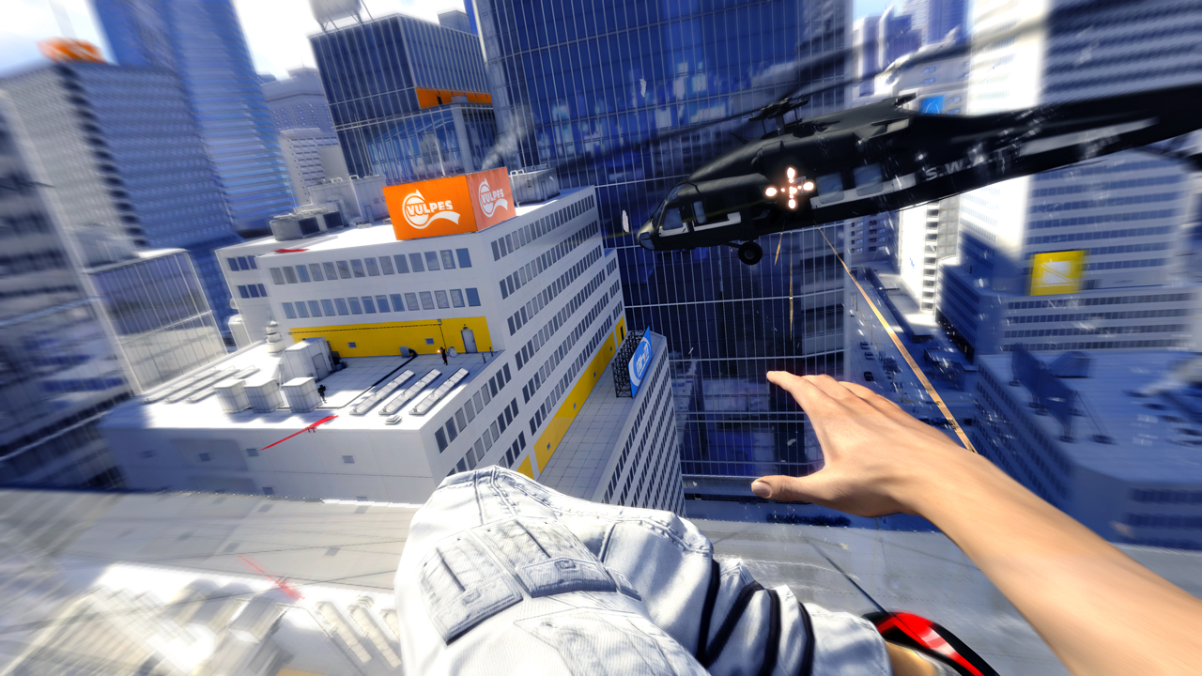
Parkour

Slide 5
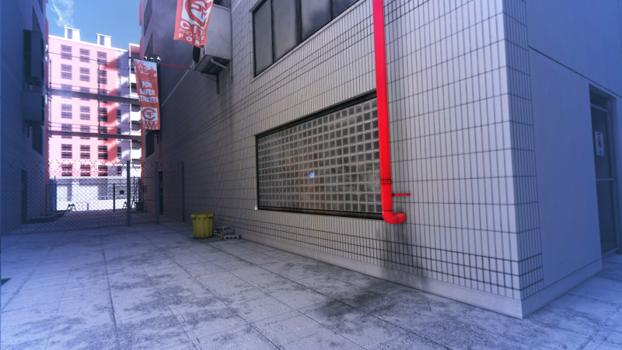
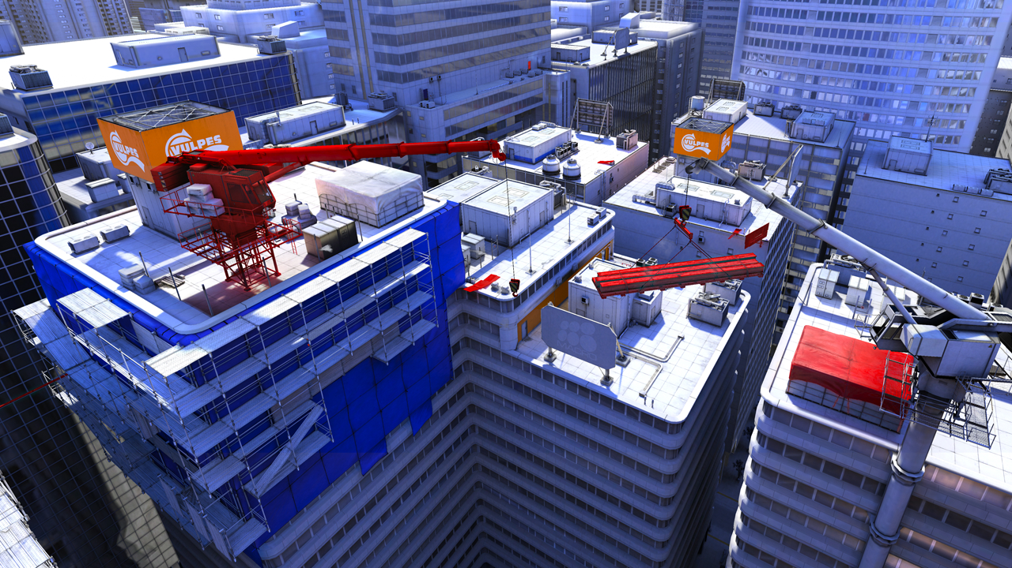
Runner's Vision

Slide 6
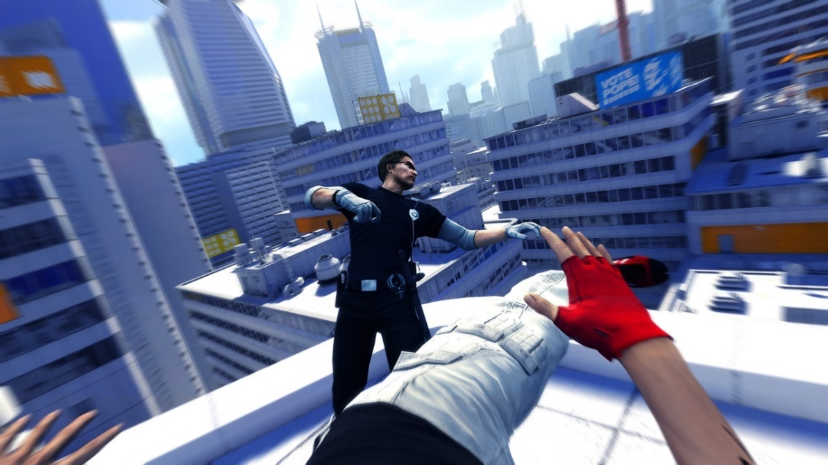
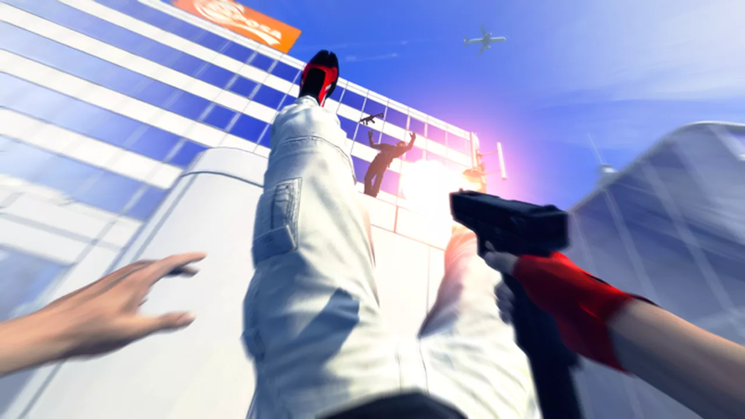
Combat

Slide 7
Technology

Slide 8
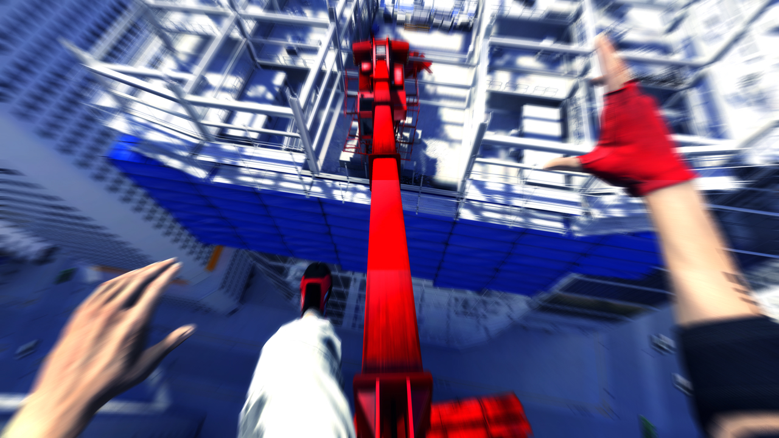
Engine
-Developed in Unreal Engine 3
-Custom "Beast" Lighting System
-PhysX Integration

Slide 9
Gameplay
https://www.youtube.com/watch?v=BAsTJi9L9PQ&feature=youtu.be

Slide 10
Thank you for your time Questions?

